Slide 1
Pt.3 Miscibility（混溶性） and Separation Lecture #9 Lattice theory: The ‘regular solution’ model The fudge factor lecture
Introduction to phase transitions
Basic thermodynamics
Simple mean-field theory of liquid/liquid mixing / phase separation

Slide 2
What causes a phase transition?
Equilibrium at global minimum of thermodynamic potential
Usually Gibbs (G) or Helmholtz (F or A) free energy P9.1
Local minima depend e.g. on T
As T changes, one local minimum can undercut（咬边） another
➔ different equilibrium state at high vs. low T
Phase transition at T_{tr} where local minima equal
Coexistence of 2 phases at T_{tr} even for single substance
Coexistence over wide T range possible in mixtures
Notes:
G = U + PV -TS = H - TS: also need to mention chemical potential
F = U - TS

Slide 3
Equilibria aren’ t everything…
Equilibrium not always reached
Energy barriers may interfere
Metastable state
Glass transition may arrest development
Also allows interesting structures to be ‘frozen’ in
Notes:
Here dG = dU +pdV + Vdp - TdS - SdT is worth introducing, because then we can use dQ = dU + pdV and dQ = TdS to simplify things.

Slide 4
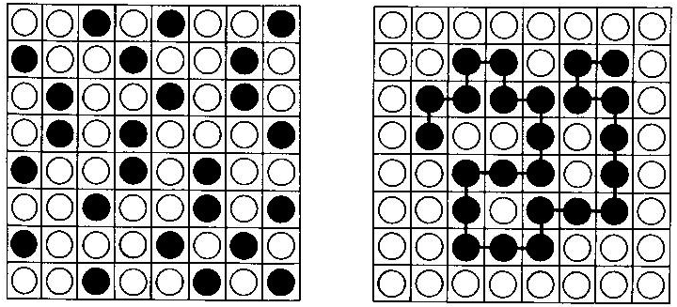
Will 2 liquids mix? PT within liquid state- no solidification or boiling
‘Lattice theory’
Mentally divide
space into cells
Each cell accommodates one molecule of either liquid, just enough cells for all molecules
z nearest neighbours
x_{A} (moles) liquid A
x_{B} (moles) liquid B
Volume fractions
Φ_{A/B} = x_{A/B} / (x_{A} + x_{B})
Φ_{A} = Φ; Φ_{B} = 1-Φ
Note symmetry A vs. B
Btw: Similar for polymer solubility
But ‘black’ component linked into
N- chain ➔ later
Assume number fraction
= Volume fraction
Concentration measured
as volume fraction
Ignore ‘excess volume’
V = const. → F = U - TS
Don’t be fooled by appearances,
we are talking about liquids,
the lattice is just a counting aide
NOT a Xtal lattice.

Slide 5
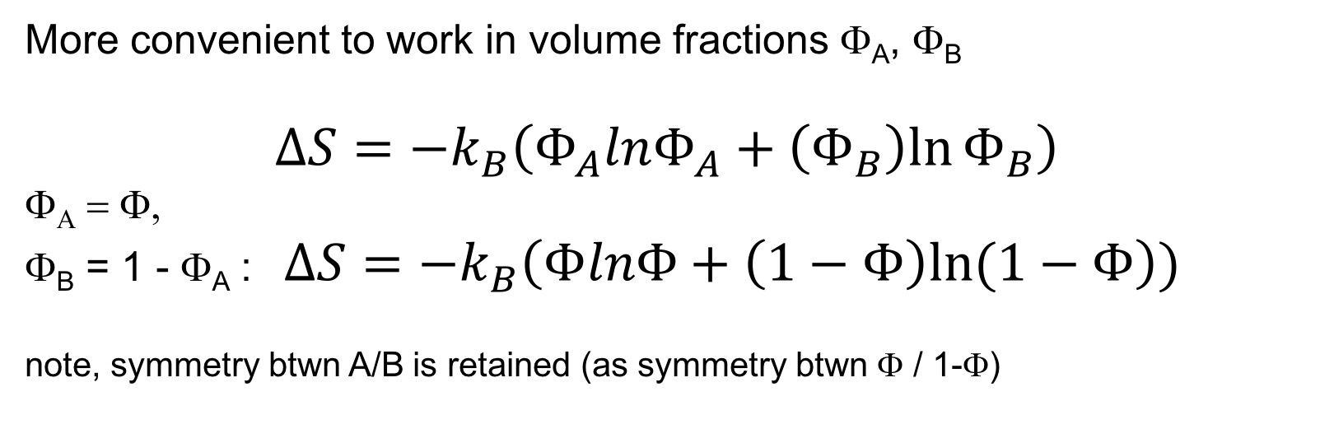

Entropy of mixing S_{mix}= ΔS ΔS = S_{mixed} - S_{separated}
‘Counting’ permutations（排列）: Separated: x_{A}!x_{B}! vs. mixed: (x_{A}+x_{B})!
Entropy S ~ ln(permutations); Stirling: ln(M!) ≈ MlnM
P9.2
More convenient to work in volume fractions Φ_{A}, Φ_{B}
$$ΔS=−k_{B}\left(Φ_{A}lnΦ_{A}+\left(Φ_{B}\right)ln⁡Φ_{B}\right)$$
Φ_{Α} = Φ,
Φ_{B} = 1 - Φ_{A} : $ΔS=−k_{B}\left(ΦlnΦ+\left(1−Φ\right)ln⁡(1−Φ\right))$
note, symmetry btwn A/B is retained (as symmetry btwn Φ / 1-Φ)
Mixing decreases F = U – TS ➔ Entropy always favours mixing
(unless we have hydrophobic interaction)

Slide 6
Energy of mixing, U_{mix} = ΔU ΔU = U_{mixed} - U_{separated}
Each molecule has an energy of interaction with its neighbours on the lattice
Like-like interactions: ε_{AA} or ε_{BB}
Like-unlike interactions: ε_{AB} = ε_{BA}
Notes:
At this point, one should introduce the lattice arguments provided by Rubinstein and Colby (and Jones in SCM). It is interesting to note that the simple lattice arguments agree with arguments based largely around perfect gases.

Slide 7

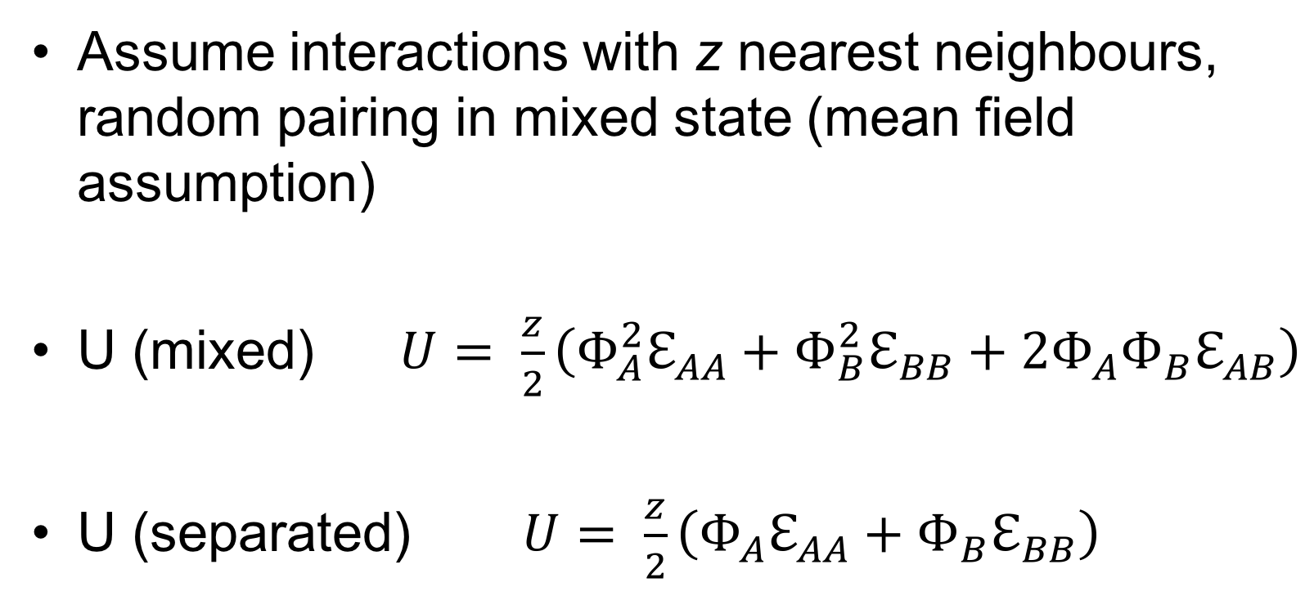
Pairwise（成对） interactions
Assume interactions with z nearest neighbours, random pairing in mixed state (mean field assumption)
U (mixed) $U= \frac{z}{2}\left(Φ_{A}^{2}ℇ_{AA}+Φ_{B}^{2}ℇ_{BB}+2Φ_{A}Φ_{B}ℇ_{AB}\right)$
U (separated) $U= \frac{z}{2}\left(Φ_{A}ℇ_{AA}+Φ_{B}ℇ_{BB}\right)$
P9.3

Slide 8
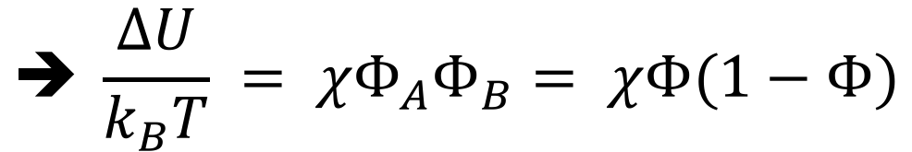
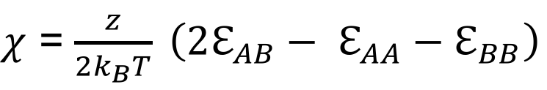
Energy of mixing, U_{mix} = ΔU ΔU = U(mixed) – U(separated)
$$U_{mix}= ΔU= \frac{z}{2}\left[\left(Φ_{A}^{2}−Φ_{A}^{ }\right)ℰ_{AA}+\left(Φ_{B}^{2}−Φ_{B}^{ }\right)ℰ_{BB}+2Φ_{A}Φ_{B}ℰ_{AB}\right]$$
Define ‘interaction parameter’ χ
dimensionless
$χ$ = $\frac{z}{2k_{B}T} \left(2ℇ_{AB}− ℇ_{AA}−ℇ_{BB}\right)$
$$➔ \frac{ΔU}{k_{B}T} = χΦ_{A}Φ_{B}= χΦ(1−Φ)$$
When A/B interact by vd Waals only: χ > 0 P9.4
ΔU often positive ➔ favours separation

Slide 9
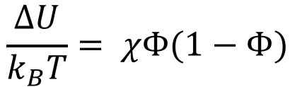
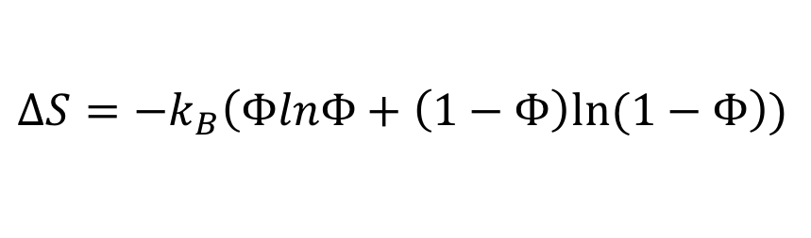
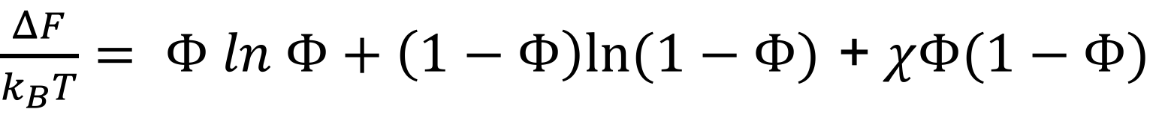
(Helmholtz) free energy of mixing
F = U –TS ➔ F_{mix} = ΔF = ΔU - TΔS
$$ΔS=−k_{B}\left(ΦlnΦ+\left(1−Φ\right)ln⁡(1−Φ\right))$$
$$\frac{ΔU}{k_{B}T}= χΦ(1−Φ)$$
$\frac{ΔF}{k_{B}T}= Φ ln Φ+\left(1−Φ\right)ln⁡(1−Φ)$ + $χΦ(1−Φ)$
(Φ_{A} = Φ, Φ_{B} = 1-Φ_{A} = 1-Φ)
Mean- field expression for liquid/liquid ΔF
Note the symmetry btwn A/B, or Φ / (1−Φ). Fails reality check…
Simple lattice theory: χ = χ(T) = A/T ←→ Reality: χ = χ(T,Φ)
➔ χ is used as ‘fudge factor’

Slide 10
Summary: Lecture #9 Lattice theory
Simple lattice- based reasoning allows calculation of entropy and energy of mixing
Entropy always favours mixing (except h’phobic entropy), energy usually favours separation
Enter the interaction parameter χ for ΔU
Energy/entropy combined into simple eqn. for F of mixing
Lattice model cuts corners e.g. ΔV, hydrophobic interaction
Use χ as ‘fudge factor’
The material contained within this lecture can be found in SCM chapter 3 up to 3.2

Slide 11
Lecture #10 Mixing and separation
Phase diagrams from ΔF / k_{B}T
Types of phase separation

Slide 12
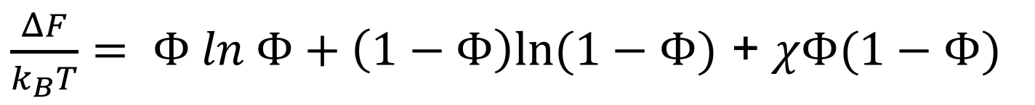
Plotting ΔF(Φ,χ)
$\frac{ΔF}{k_{B}T}= Φ ln Φ+\left(1−Φ\right)ln⁡(1−Φ)$ + $χΦ(1−Φ)$
from SCM
T dependency
Implied in χ
Note symmetry
w.r.t. Φ / 1−Φ
χ_{cr} = 2
Φ

Slide 13

Stability, instability, metastability, coexistence
from SCM
ΔF(Φ) convex:
Stable mix
Phase separation
into 2 co- existing
liquid phases
Vol. fraction α @ Φ₁
1 - α at Φ₂
$$αΦ_{1}+\left(1−α\right)Φ_{2}=Φ0$$
In the right hand diagram, φ₁ and φ₂ are known as co-existing compositions.
Not pure substance A/B! 1/2 ≠ A/B!
Unstable, not even locally stable
Globally unstable,
but locally stable ‘metastable’
P10.1
Notes:
Need to be clear about the difference between volume fractions and the fractional volume covered by each component. One must not mistake volume fraction for 100% of one component covering phi% of the volume. Therefore the factors f need to be introduced.

Slide 14
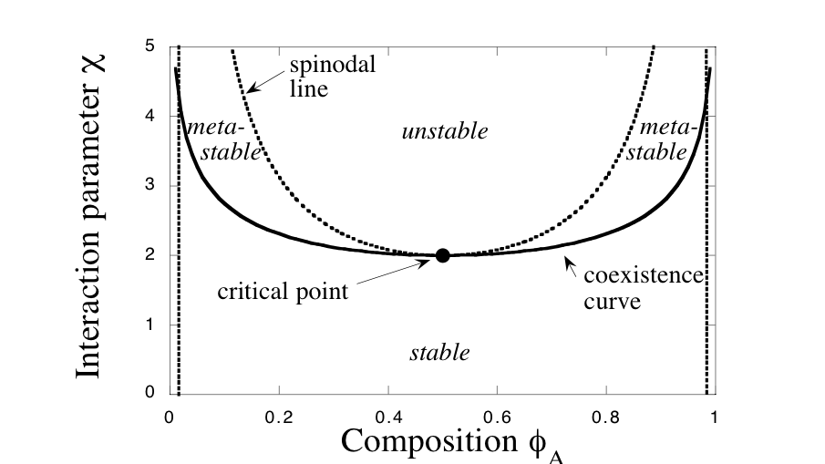
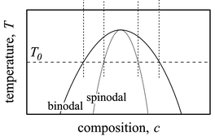
Phase diagrams
‘Universal’ binary phase diagram
(Φ/χ) plane
Specific phase diagram Φ/T plane
(χ(T) not universal)
Coexistence curve aka ‘binodal’ or ‘cloud point curve’ (stable/metastable): d(ΔF/k_{B}T)/dΦ = 0
Spinodal: Metastable/unstable d²(ΔF/k_{B}T)/dΦ² = 0
Critical point:
1st/2nd/3rd derivative ΔF/k_{B}T to Φ = 0 ➔ χ_{crit} = 2
‘Upper Critical Solution Temperature’ T_{cr}
UCST
Note, Φ symmetry / Φ_{cr} = ½ w/in lattice model – but not in reality!
P10.2
from SCM

Slide 15
Forms of phase separation
Spontaneous (spinodal decomposition)
Requires no activation energy/nucleation
Leads to ‘kinetic’ pattern formation: One length scale grows fastest (Cahn Hilliard model, more in SCM 3.3.2 onwards)
Metastable (binodal decomposition): Nucleation required
Homogeneous nucleation
Thermal activation required
Heterogeneous nucleation
Impurities allow one phase to condense, triggering phase separation

Slide 16
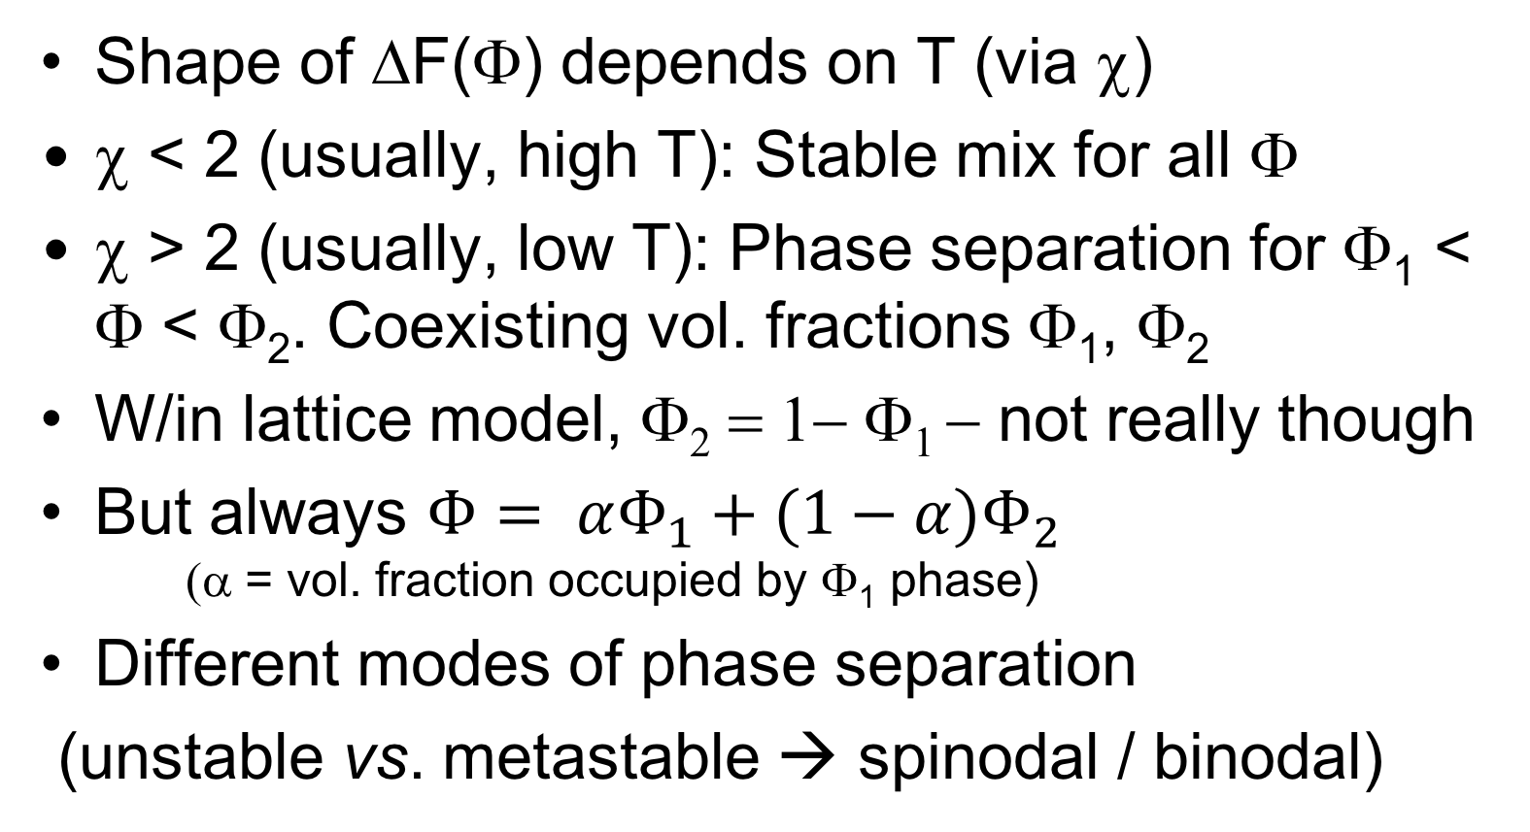
Summary Lecture #10 Mixing and separation
Shape of ΔF(Φ) depends on T (via χ)
χ < 2 (usually, high T): Stable mix for all Φ
χ > 2 (usually, low T): Phase separation for Φ₁ < Φ < Φ₂. Coexisting vol. fractions Φ₁, Φ₂
W/in lattice model, Φ₂ = 1− Φ₁ − not really though
But always $Φ= αΦ_{1}+(1−α)Φ_{2}$ (α = vol. fraction occupied by Φ₁ phase)
Different modes of phase separation
(unstable vs. metastable → spinodal / binodal)
This is in SCM 3.2

Slide 17
Lecture #11 Polymer solubility and miscibility Another Flory lecture
Extending the lattice model to polymer solutions

Slide 18
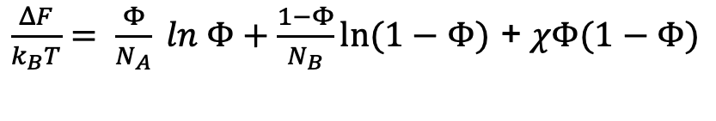
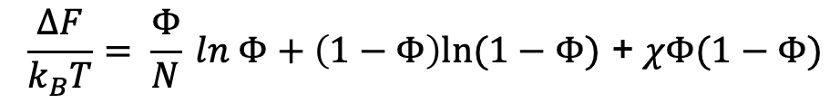
Lattice theory for polymer solutions/blends ’Flory- Huggins theory’
Polymer solution
N: Degree of polymerisation (‘length’)
x_{A}/N (moles) polymer
x_{B} (moles) solvent
Volume fractions
Φ_{A/B} = x_{A/B} / (x_{A} + x_{B})
Φ_{A} + Φ_{B} = 1
Φ_{A} = Φ, Φ_{B} = 1 - Φ
Solution:
Blend:
Polymer blend
x_{A}/N_{A}(moles) Polymer A
x_{B} /N_{B} (moles) Polymer B
Volume fractions
Φ_{A/B} = x_{A/B} / (x_{A} + x_{B})
Φ_{A} + Φ_{B} = 1
=> Φ_{A} = Φ, Φ_{B} = 1 - Φ
$$\frac{ΔF}{k_{B}T}= \frac{Φ}{N} ln Φ+\left(1−Φ\right)ln⁡(1−Φ)\text{ + }χΦ(1−Φ)$$
$\frac{ΔF}{k_{B}T}= \frac{Φ}{N_{A}} ln Φ+\frac{1−Φ}{N_{B}}ln⁡(1−Φ)\text{ + }χΦ(1−Φ)$
Entropy N- times reduced by ‘chain’ condition
Solution: χ_{cr} → ½ for N → ∞ ; Blend: χ_{cr} → 0 for (N_{A} and N_{B} ) → ∞

Slide 19

‘Incompatibility’
Polymer solutions:
Entropy of solution significantly reduced
Solvents must be chosen carefully
Rule- of thumb: matching
‘Hildebrand’ parameter δ
There are exceptions (e.g. acid/base)
Polymer blends:
Entropy of mixing btwn 2 high N polymers virtually zero
Mixing must be enthalpy (χ) driven- but usually isn’t - most polymers phase- separate
Exceptions, e.g. PMMA/PVC
‘Incompatibility’ troublesome for polymer recycling
Incompatible polymers may still share common solvent
Separation may be arrested by T_{g}
Chemistry wins (block/graft copolymers, e.g. HIPS, ABS)

Slide 20
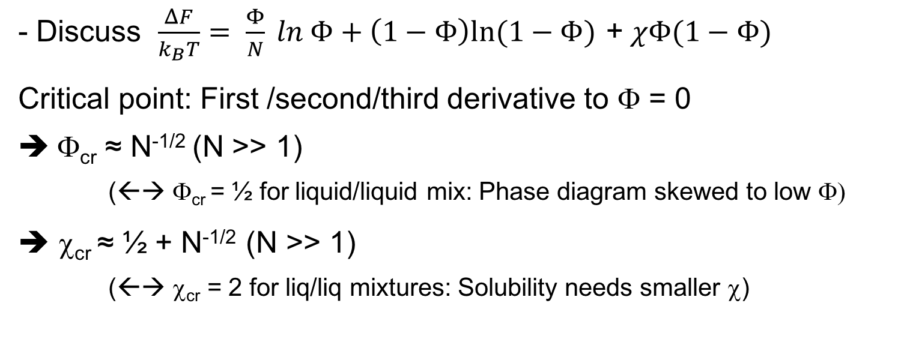
Polymer solubility: The Θ temperature
- Discuss $\frac{ΔF}{k_{B}T}= \frac{Φ}{N} ln Φ+\left(1−Φ\right)ln⁡(1−Φ)\text{ + }χΦ(1−Φ)$
Critical point: First /second/third derivative to Φ = 0
Φ_{cr} ≈ N^{-1/2} (N >> 1)
(←→ Φ_{cr} = ½ for liquid/liquid mix: Phase diagram skewed to low Φ)
➔ χ_{cr} ≈ ½ + N^{-1/2} (N >> 1)
(←→ χ_{cr} = 2 for liq/liq mixtures: Solubility needs smaller χ)
Flory defined Θ Temperature by χ(Θ) = ½
½ = Limit of χ_{cr} for N → ∞; (Θ − T_{cr} ) ~ N^{-1/2}
< ½ : Good solvent, R ~ N^{3/5}
= ½: Θ solvent, R ~ N^{1/2}
> ½: Poor solvent (or non- solvent), R ~ N^{1/3}

Slide 21
Example Θ− Systems / Temperatures
Polymer | Solvent | Θ [ºC]
Polystyrene (PS) | Cyclohexane | 35
Polystyrene (PS) | Decalin | 27
Poly(α-methylated)styrene | Cyclohexane | 34
Polymethyl methacrylate (PMMA) | 4-Heptanone | 32
Polyacrylic acid | Dioxan | 29
Polymethacrylonitrile | Butanone | 6
Polyethylene (PE) | Nitrobenzene | 230
Polyethylene (PE) | Biphenyl | 125
Polypropylene (PP) | Diphenyl ether | 133
Polyisobutylene | Diisobutylketone | 58
condition is property of Polymer/solvent system
‘Θ solvent’ is meaningless without specifying the polymer, and the Θ temperature

Slide 22
‘Flory Huggins’ interaction parameter χ when used for polymer solutions
Often of the form χ = -A + B/T
Sometimes φ is included
Composition dependent χ is more complicated
These are UCST phase diagrams if B > 0
Upper critical solution temperature
Sometimes we have LCST phase diagrams
Here different expansivities may be important
Water as solvent / hydrophobic interaction
Other possibilities
Both LCST and UCST in the same mixture and “hour glass” forms are possible

Slide 23
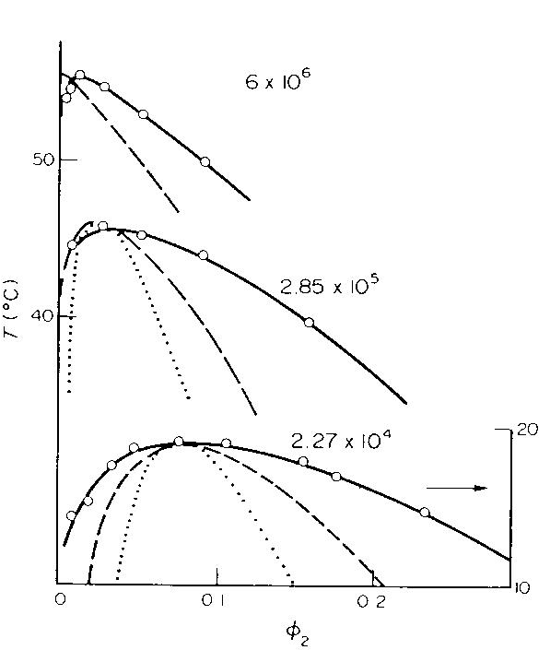
Phase diagrams for χ = -A + B/T
Θ
UCST Phase diagrams
T_{cr} increases as N increases
Φ_{cr} decreases as N increases
Limit N → ∞: T_{cr} → Θ, Φ_{cr} → 0
(Θ − T_{cr} ) ~ N^{-1/2}
P 11.1
Polyisobutylene/Diisobutylketone
M_{w} up: UCST → Θ = 58 ºC, Φ_{c} → 0

Slide 24
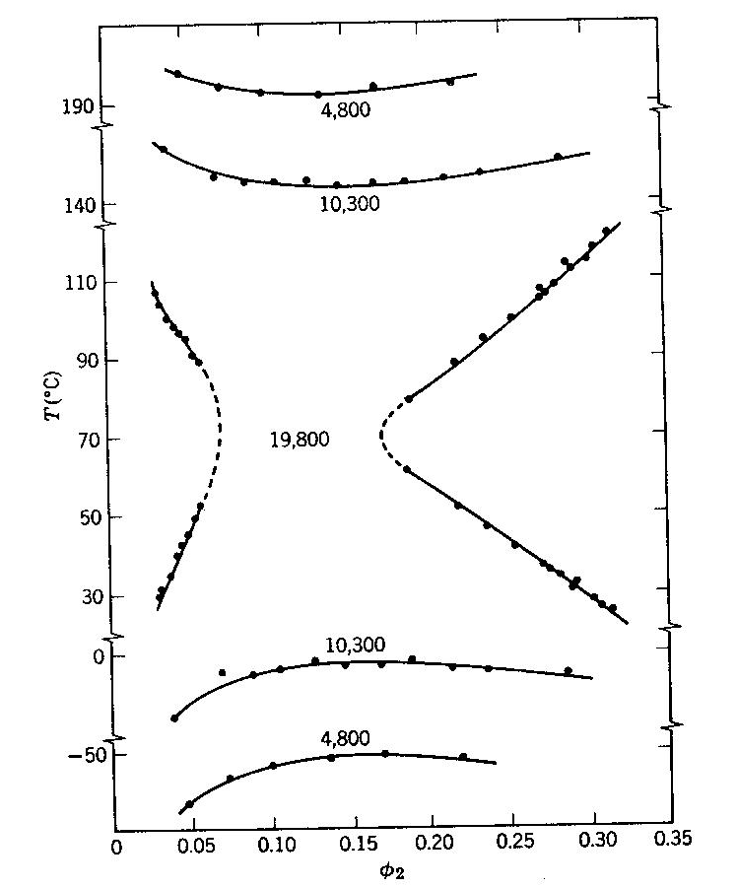
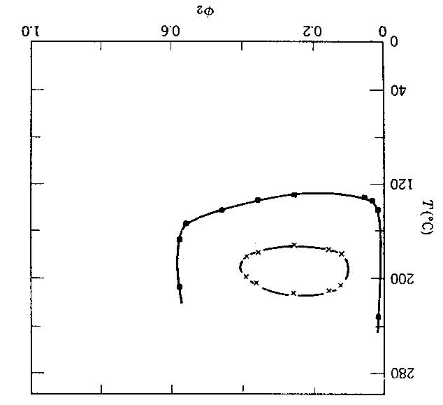

χ ≠ -A + B/T: Other phase diagrams
PS/acetone
Different
Mol. Wt.
Both UCST and LCST
(low M Wt)
High M Wt:
Upper T_{cr} drops below lower T_{cr}
’Hourglass’
Poly(ethylene oxide)/water
(  M = 5000 g/mol,
x M = 3000 g/mol)
‘Lower critical solution Temperature’
LCST
Hydrophobic (and similar) interactions:
Entropic contributions other than combinatorial S
(Wrongly) accounted for as enthalpies, fudged into χ

Slide 25
Summary: Lecture #11 Polymer solubility and miscibility
Lattice model can be adapted to polymer solutions and blends
Entropy of mixing is reduced N- fold
Most polymers are ‘incompatible’, i.e. don’t mix with other polymers
Most polymers still dissolve in well- chosen solvents
Polymer/solvent phase diagrams are skewed to low Φ_{polymer} (i.e. critical point at Φ_{polymer} << ½)
Key concept in polymer solution thermodynamics: Θ temperature / solvent / condition
SCM does not deal with polymer solutions as prominently as specific polymer science texts. Cowie and Arrighi dedicate a full chapter to polymer solutions. And H Morawetz, ‘Macromolecules in Solution’, dedicates a whole textbook.

